Slide 1
10/29/2024

Slide 2
Meeting Agenda
Education Module
Pitch from Blockchain/Crypto
Discussion
Vote
Industry Updates
Notes:
Grace

Slide 3
Education Module: BlockChain and CryptoCurrency

Slide 4
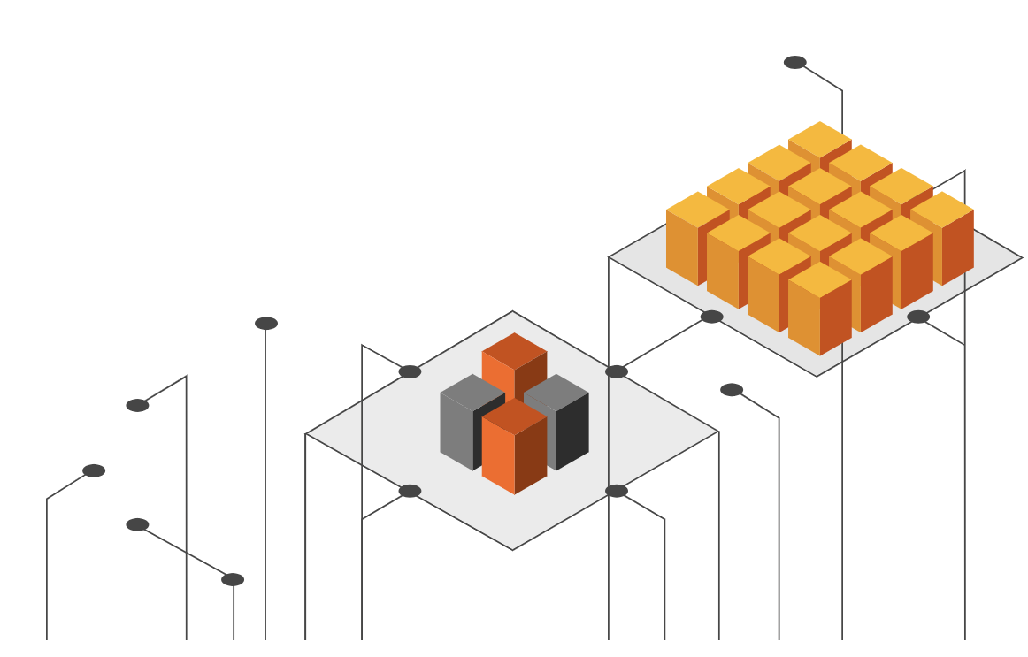
What is Blockchain?
Decentralized (no single body/org), distributed ledger
Secure, transparent, and immutable record-keeping system
Enables peer-to-peer transactions without intermediaries
The technology that enables the existence of crypto (and other things)

Slide 5
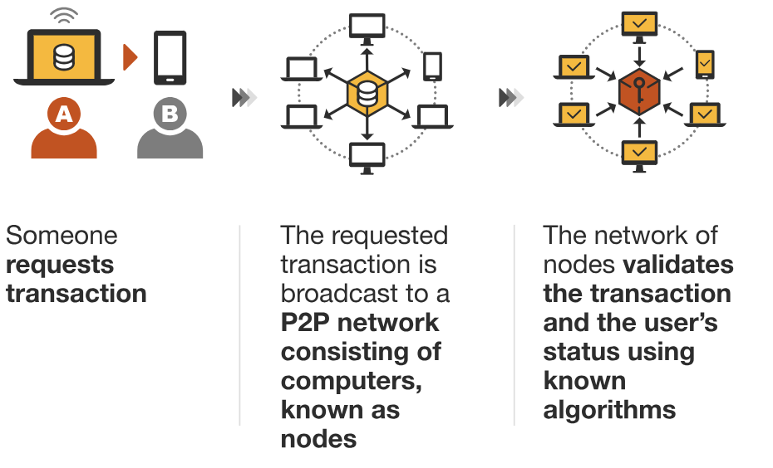
Blockchain Value Chain (1/2)
Source: PWC
Notes:
https://www.pwc.com/us/en/industries/financial-services/fintech/bitcoin-blockchain-cryptocurrency.html

Slide 6
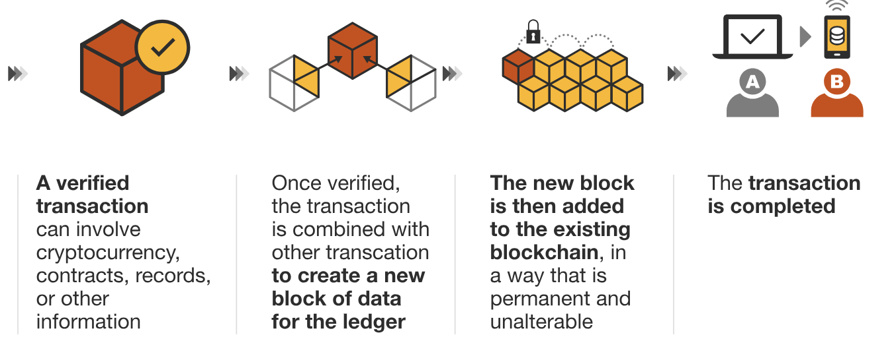
Blockchain Value Chain (2/2)
Source: PWC
Notes:
https://www.pwc.com/us/en/industries/financial-services/fintech/bitcoin-blockchain-cryptocurrency.html

Slide 7
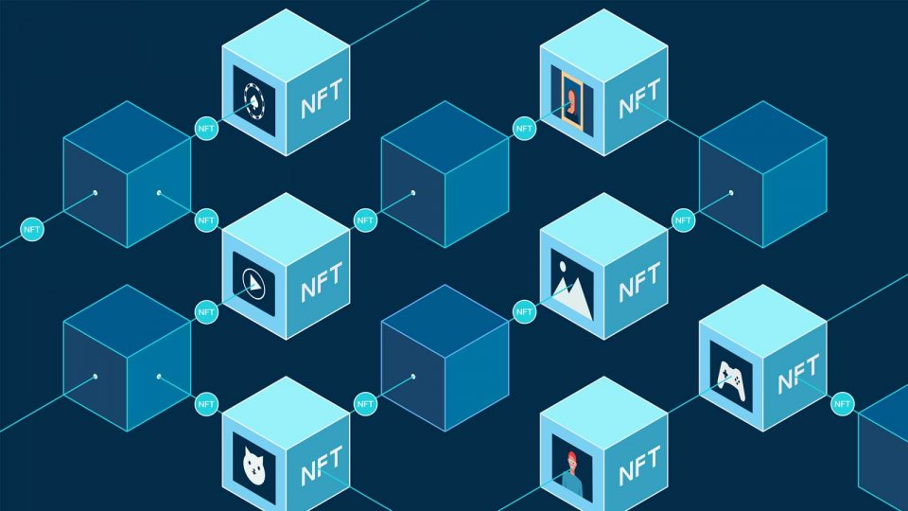
Blockchain
Benefits
Drawbacks
Improved transparency/visibility of transactions
Improved management of resources by way of collection and distribution of decentralized data
Reduction of intermediary costs
Access to new financial capital
Implementation issues and competitors
Payments security concerns
Lack of knowledge
Source: PWC, Stanford Business School
Notes:
https://www.pwc.com/us/en/industries/financial-services/fintech/bitcoin-blockchain-cryptocurrency.html
https://www.gsb.stanford.edu/faculty-research/publications/creating-value-blockchain-value-chain-management-perspective

Slide 8
What is Cryptocurrency?
Virtual currency using cryptography for security
Uses blockchain technology
Again, not controlled by 1 body (e.g., governments, banks, etc)

Slide 9
Examples of Cryptocurrencies
Bitcoin (BTC): First and most well-known
1 BTC ~ $57,846.10 USD (as of September 16 2024)
Ethereum (ETH): First and most well-known
1 ETH ~ $2,357.76 USD (as of September 16 2024)
Ripple (XRP): Designed for fast, low-cost internal transfers
1 XRP ~ $0.58 USD (as of September 16 2024)
Each “coin” is designed differently.
BTC: Data on BTC network is only used to record transaction info
ETH: Transactions on ETH network may contain executable code

Slide 10
Real-world use of Blockchain/Crypto
Digital payments and transfers (purchases)
Smart automated contracts
Stablecoins: coins with price tied to oil, precious metals, other tangible assets
Investments & Trading
NFT’s: Art that cannot be copied in the eyes of the ledger

Slide 11
How Crypto is Made
Crypto is “mined” which involves different mechanisms called Proof of Work (PoW) or Proof of Stake (PoS)
PoW: Miners (GPU’s) compete to solve complex mathematical problems
Expensive electricity and hardware requirements
PoS: Owners offer their coins as collateral “staking” for the chance to validate/mine
Less energy / compute intensive

Slide 12
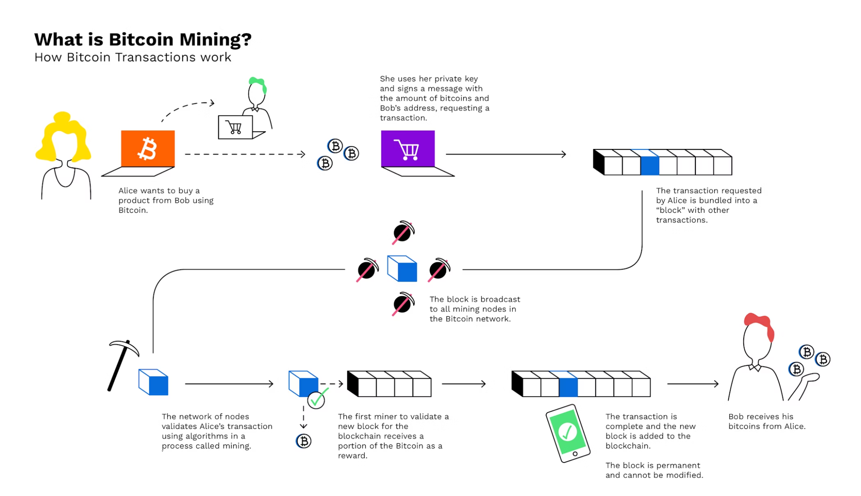

Slide 13
Proof of Work (PoW) System
Crypto is basically alive based on the number of miners, who provide a network of “nodes” for the crypto to be validated
Miners solve complex math problems to be the first ones to validate transactions on blockchain
The blockchain can’t be changed or altered, ensuring no one can spend the same unit of currency twice
When a miner wins, it’s broadcast to the network and verified by the other nodes
PoW system proves miners’ attempts with energy expended (competitive)
Notes:
https://www.bitpanda.com/academy/en/lessons/what-is-bitcoin-mining-and-how-does-mining-work/

Slide 14
Proof of Stake (PoS) System
A blockchain consensus mechanism allowing holders to validate transactions based on their cryptocurrency holdings
The more cryptocurrency a person "stakes" (locks in), the higher their chance of being chosen to validate blocks and earn rewards
PoS is less energy-intensive than Proof of Work (PoW), as it doesn't require extensive computing power
Validators are motivated to act honestly since they can lose their staked coins for misconduct
More random than PoW
Notes:
https://www.investopedia.com/terms/p/proof-stake-pos.asp

Slide 15
NFTs (Non-Fungible Tokens)
Unique digital blockchain assets
Represent ownership of a specific item, making them non-fungible (unlike bitcoin and ethereum)
Key characteristics:
Unique
Indivisible
Proof of ownership

Slide 16
NFT Creation/Process
Creation: artists/creators produce a digital file (artwork, video, music, etc.)
Minting: file is uploaded to an NFT platform (like OpenSea) and "minted," where it’s stored on the blockchain (typically Ethereum, Polygon, or Solana)
Tokenization: creator assigns properties and a unique identifier is attached
Royalties: creators earn a percentage of future sales

Slide 17
NFT Uses
Art & Collectibles: Digital artwork, trading cards, and virtual collectibles.
Gaming: In-game items and characters as NFTs that can be owned, traded, or sold.
Virtual Real Estate: Ownership of virtual spaces in metaverses like Decentraland.

Slide 18
Pitch

Slide 19
Discuss & Vote!

Slide 20
Industry Updates

Slide 21
Justice Department Sues Visa :)
Visa accused of maintaining an unlawful monopoly in the debit card payments market
Engaging in exclusive agreements that restrict competition and hinder new entrants
Raises prices for everyone
DOJ’s action aims to dismantle monopolistic practices, fostering a more competitive and fair debit card payment landscape

Slide 22
Trump’s Pro-Crypto Policies
Reforming the SEC(Security and Exchange Commission)
Fire Gary Gensler(current head)
Create a new strategic bitcoin reserve
Requiring the FED to hold Bitcoin as a reserve asset(like gold)
Buying 1 million Bitcoin over 5 years, holding for 20 years
Prevent the creation of a central bank digital currency
Trump’s personal gains: World Liberty Financial(insider - sell non-transferable tokens)
What should be regulated by the SEC?
Notes:
SEC - regulating financial assets in the US
Democrats challenge crypto progress
Digital dollar: helps with tackling tax evasion, money laundering, terrorist financing, provide better knowledge for states of their economy(better economic policies)

Slide 23
IRS Announces 2025 Tax Brackets
Standard Deduction Increase:
Single Filers increases to $15,000 (up $400)
Joint Filers increases to $30,000 (up $800)
Marginal Tax Bracket:
Income thresholds for all brackets adjusted slightly upwards
Earned Income Tax Credit (EITC)
Max EITC for families with 3+ children increases to $8046 (up $216)
Changes reflect inflation adjustments
Reduces Tax Burdens
Increase Deductions & Income Thresholds
Prevents taxpayers from entering higher tax brackets
Notes:
Sources: https://www.irs.gov/newsroom/irs-releases-tax-inflation-adjustments-for-tax-year-2025
https://irs.gov/newsroom/irs-provides-tax-inflation-adjustments-for-tax-year-2024

Slide 24
Robinhood starts Election Betting Market
Robinhood has launched a betting market for the presidential election only for US citizens
Users can wager on presidential candidates, Kamala Harris and Donald Trump, via event contracts (priced between $0.02 and $0.99 | $1 payout | 5000 contracts max per user)
aims to engage users in political events
It reflects the increasing interest in political betting
However, launch raises questions about the implications of gambling on political outcomes:
Commodity Futures Trading Commision (CFTC) has expressed concerns regarding its influence on the integrity of election
Notes:
Sources:
https://www.forbes.com/sites/dereksaul/2024/10/28/robinhood-launches-presidential-election-betting-market-allowing-users-to-wager-on-harris-and-trump/
https://www.cnbc.com/2024/10/28/robinhood-jumps-into-election-trading-giving-users-chance-to-buy-harris-or-trump-contracts.html

