Slide 1
2/25 Meeting

Slide 2
Roadmap of the Meeting
Updates
Portfolio Details
1
3
2
4
Current Events
Important Forms/Links

Slide 3
1. Updates

Slide 4
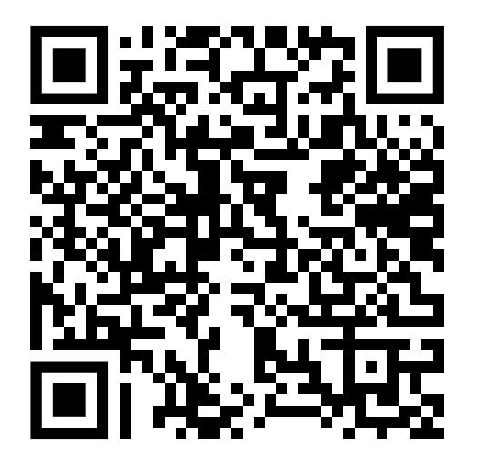
Updates
Take a minute to sign up for a pitch

Slide 5
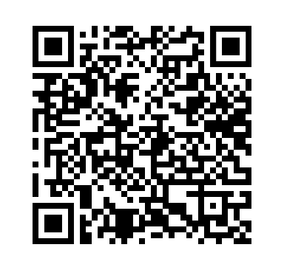
Updates
Take a moment to sign up for a current event presentation

Slide 6
2. Current Events

Slide 7
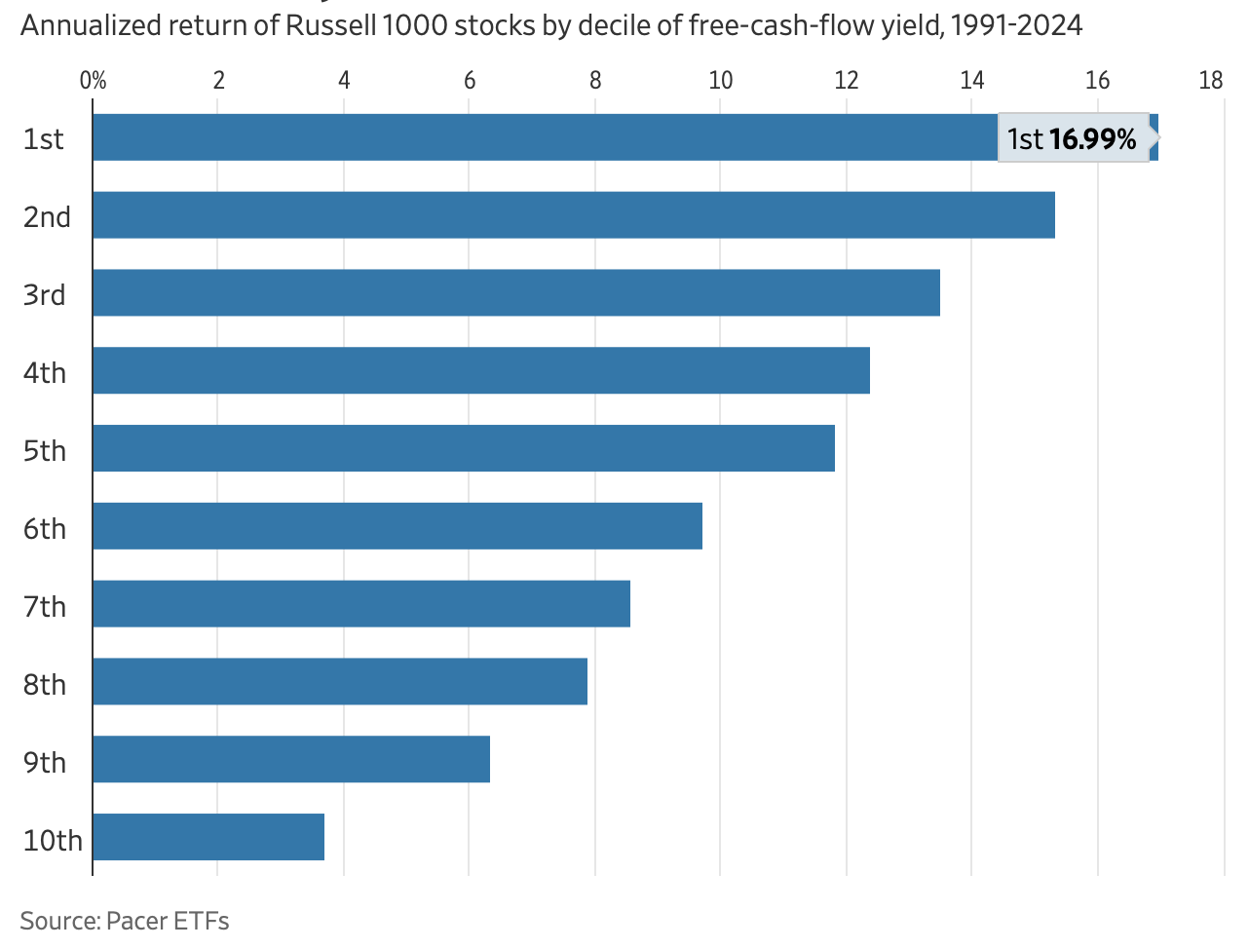
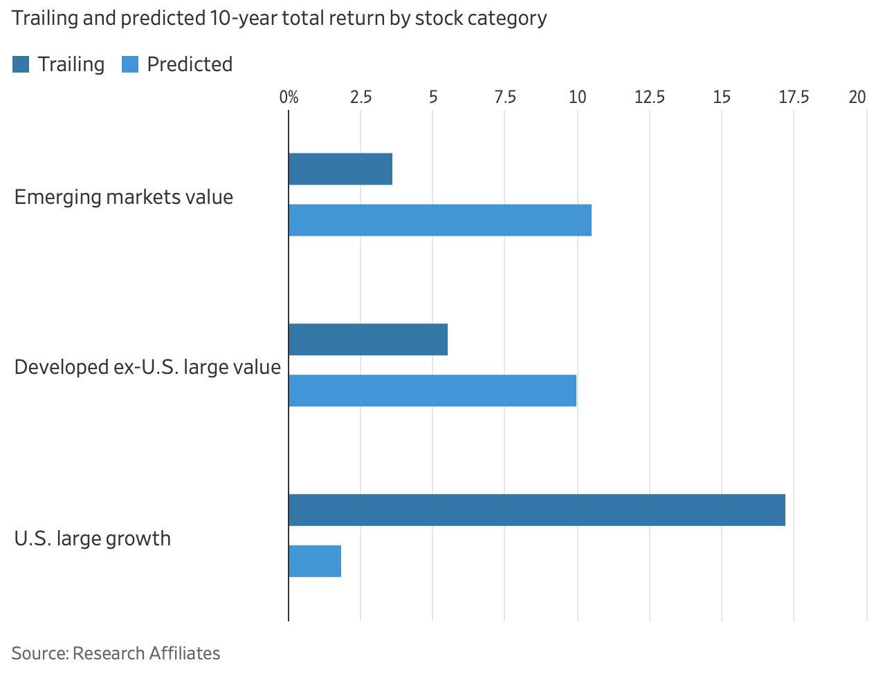
A shift in the stock market—the move from MAG7 to emerging markets
Datatrek research analysts found usual correlation of S&P 500 and MSCI EAFE (0.83), has been a meager 0.54 in the past ~100 days
Presidential election initially supercharged US stocks and strengthened the dollar. Now backtracking, defense spending call to action for US allies, movement back
With instability, shift from MAG7 back to value investing
Read more here

Slide 8
Trump’s Meme Coins - Good or Bad?
First sitting president to create and commercialize own cryptocurrency/meme coin
$TRUMP hit $15B market cap, now decreased significantly to $3B - rug pull?
80% owned by trump affiliated organizations
Signed executive order to create national digital currency stockpile
Lack of openness and engagement with previous administration, now entirely different

Slide 9
3. Case Study

Slide 10
Overview of Visa
“Payment Facilitator”: Visa facilitates digital payments between 4 parties:
Cardholders: consumers that make purchases
Merchants: businesses that accept card payments
Issuer Banks: banks that provide Visa-branded cards
Acquirer Banks: banks that process payments for merchants
Revenue Generation: collect transaction processing fees
Scale: $15.7 trillion in total volume, $234 billion through Visa’s network
Competitors: Mastercard, Amex, PayPal, Stripe
Global Reach: spanning 200+ countries (41% North America, 30% Asia)
Notes:
Will take five and vote from them

Slide 11
Revenue Streams
Data Processing Revenue (36%): authorization, clearing, settlement, and value-added services (fraud prevention, reducing friction, risk management)
Service Revenue (32%): charging financial institutions as % of transaction volume
International Transaction Revenue (26%): cross-border transactions and currency exchange activities
Other Revenue (6%): smaller value-added services like licensing fees, advisory, etc
Revenue Drivers:
Increasing volume of transactions processed
Partnering with more financial institutions
Improving value-added services
Notes:
Smart contracts: smart contract is a computer program or a transaction protocol that is intended to automatically execute, control or document events and actions according to the terms of a contract or an agreement
TPS: Transactions Per Second
Scalability

Slide 12
Competitive Advantages
Global Reach:
VisaNet processes transactions at high speed (65,000+ per second) with top-tier security.
Accepted in 200+ countries, making it a go-to network for fintechs scaling globally.
Fintech Partnerships & Open Network Model:
Unlike closed-loop systems (e.g., Amex), Visa collaborates with banks, neobanks, and fintech startups.
Provides APIs and infrastructure to power digital wallets, BNPL (Buy Now, Pay Later), and embedded finance solutions.
Tech:
Invests heavily in AI-driven fraud detection, tokenization, and blockchain.
Expanding capabilities in real-time payments, open banking (Plaid acquisition), and cross-border transactions.
Asset-Light model:
Unlike traditional banks, Visa does not issue credit, avoiding lending risk while profiting from transaction volume.
Generates revenue from interchange fees, cross-border transactions, and data analytics.
Notes:
Locking tokens to support network security: Users commit (stake) their cryptocurrency to help validate transactions and maintain the blockchain.
Earn rewards: In return for staking, participants receive rewards (similar to earning interest).
Risk of slashing: If validators act dishonestly or fail to participate, they may lose part of their stake.
Technically, PoH itself is not a mining mechanism like Proof of Work (PoW). Instead, PoH is used as a time-ordering mechanism within Solana’s Proof of Stake (PoS) system. Here’s how it works:

Slide 13
Recent Headlines and Future Catalysts
Acquisition of Featurespace: Visa completed the acquisition of Featurespace in December 2024, strengthening its fraud prevention capabilities.
Financial Results: Visa reported strong fiscal first quarter 2025 financial results on January 30, 2025, with +1.83% surprise in w revenue growth and +3.34% surprise in EPS growth.
Stock Price Target Increase: TD Cowen raised Visa's stock price target to $382, citing the company's strong market position and growth potential.
Value-Added Services and New Flows: These underappreciated drivers are expected to boost Visa's performance and market valuation, potentially increasing from over 30% of net revenue in FY24 to more than 50% in the future.
Visa Direct Expansion: Visa announced that Visa Direct will make funds available in U.S. cardholders' bank accounts in one minute or less, enhancing its money movement capabilities.

Slide 14
Interactive Activity
Let’s say you started a company called Asiv intended on competing against Visa and Mastercard. How would you approach differentiating yourself and taking market share against this duopoly?

Slide 15
Portfolio Tracking

Slide 16
Cryptocurrency
Equity Investments
$4710 position in Ripple
Down 21.50% since (1/28)
$2220 position in Fwog
Down 44.49% since (1/28)
$7040 position in Robinhood
Up 2.36% since (1/28)
$4768 position in Coinbase
Down 19.43% since (1/28)
$3973 position in Corpay
Down 4.69% since (1/28)

Slide 17
Important Forms

Slide 18
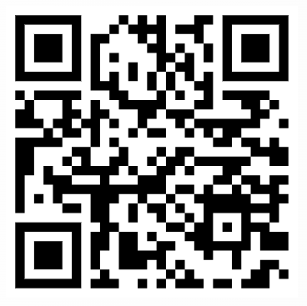
Join Our Slack For Communications

Slide 19
5.
Questions?
Email us: fintech@brown.edu

Slide 20
Thank You
We hope to see you back here next Tuesday @ 7 pm → Friedman 208

