Slide 1
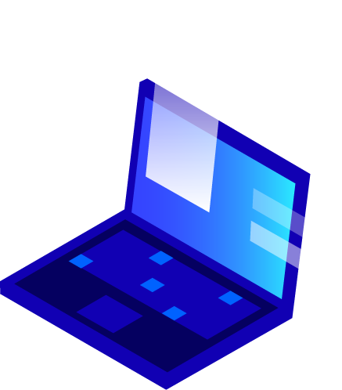
10/1/2024

Slide 2
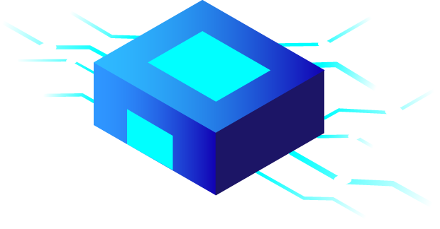
1.
Logistics

Slide 3
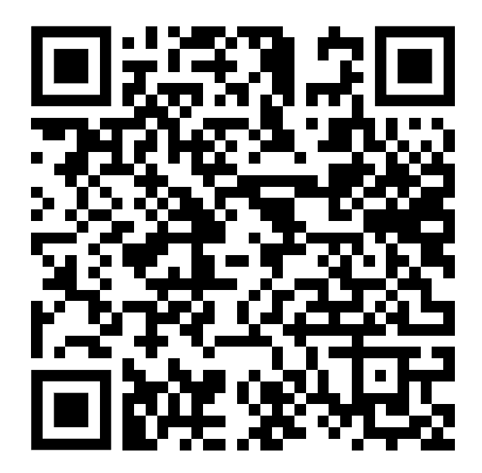
Pitch Sign-Up
Please sign up for at least one pitch this semester.
https://docs.google.com/spreadsheets/d/1vxnMgKtETUAK5p0hdYsHl1In3CNw3v7SpMAQ2Rh04yg/edit?usp=sharing

Slide 4
2.
Networking 101

Slide 5
What does it mean to Network?
Essentially a way of reaching out to people in the role that you desire to have
Benefits of Networking:
Learning | Recruiting
Networking is a great way to learn about what exactly people in this role do, whether it be the role in general or more specifically about the work in a specific group | It is critical to network during recruiting. It gets your name out to the company and put you on their radar. If a company has a recruiting team it will be a lot easier for them to discuss your candidacy if they know your name!
NETWORK, NETWORK, NETWORK!!!

Slide 6
How to Network:
LinkedIn or Cold Email are the most common ways of reaching out.
When to Use LinkedIn vs. Email:
Email | LinkedIn
More effective in reaching people - especially at more well known banks. There are common email templates you can follow and send a cold email to. | When you are unable to find a person’s email or if you really want to speak with someone and they have not responded to your email. LinkedIn is great at FINDING people who you can then email.
Remember: NETWORK, NETWORK, NETWORK!!!

Slide 7
LinkedIn
MAXIMIZE THE BROWN ALUMNI NETWORK!!!!!!
Finding the Person | Crafting the DM
In-person LinkedIn Website Tutorial | LinkedIn DM Template
Components of LinkedIn Searching:
NETWORK, NETWORK, NETWORK!!!

Slide 8
Emailing
MAXIMIZE THE BROWN ALUMNI NETWORK!!!!!!
Finding the Email Address | Crafting the Email
Email Formats | Cold Email & Thank You Email Templates
Components of Cold Emailing:
NETWORK, NETWORK, NETWORK!!!

Slide 9
3.
Example Pitch

Slide 10
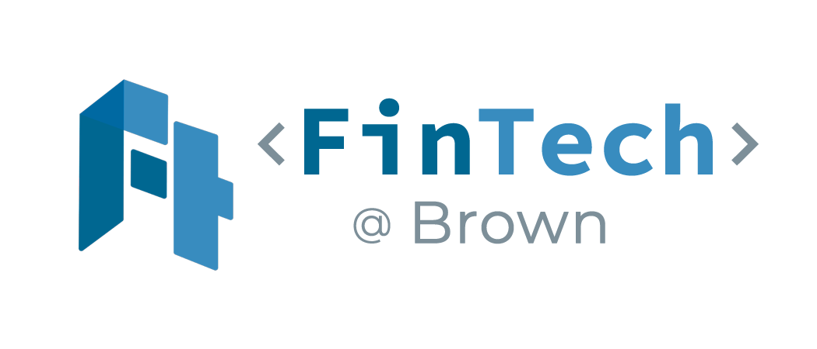
Toast, Inc. (NYSE: TOST)
INSERT_COMPANY_LOGO (e.g. Toast)
Fintech@Brown
March 12th, 2024

Slide 11
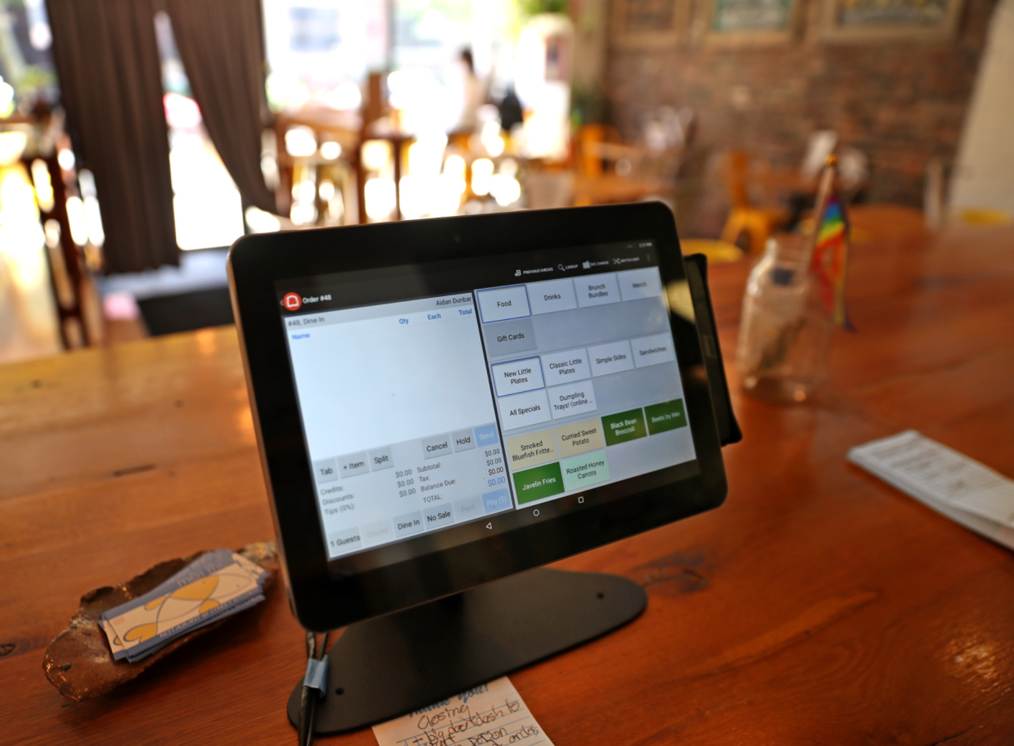
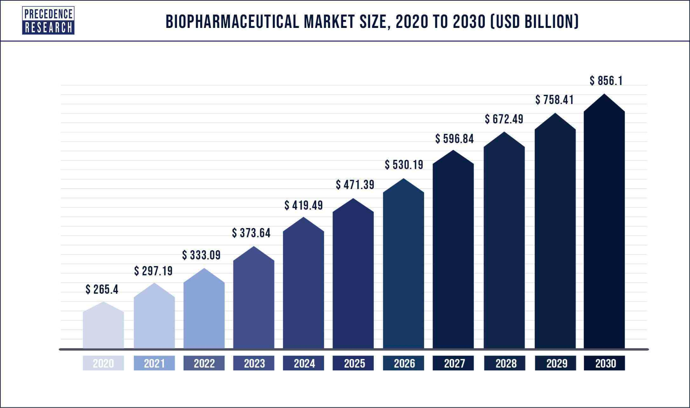
Company Background
The Business
Enter_Information
Bullet_Point
Enter_Information
Bullet_Point
Origin/History
Enter_Information
Enter_Information
Enter_Information
Enter_Information
Management Team
Enter_Information
Enter_Information
Bullet_Point
Competitive Advantages & Disadvantages
Enter_Information
Bullet_Point
Enter_Information
Bullet_Point
Notes:
phases for fda approval – phase 1: safety and dosage (<50); phase 2: effectiveness and side effects (100); experimental comparison to other treatments/efficacy in long run (100-1000s); submit for fda review and approval
compared to only 23 in phase 3 and 4 in registration last year around this time
largest M&A transaction in the biopharma industry
pfizer largest rival is JNJ in terms of market cap and total revenue (397 billion)but JNJ also develops
By 2030, the global biopharmaceutical market is projected to reach $856.1 billion and predicted to expand at a compound annual growth rate (CAGR) of 12.5%.
Pfizer also stands to lose approximately $17 billion in sales over the next several years due to the loss of exclusivity (LOE) on several large drug franchises: Ibrance (breast cancer) and Eliquis https://www.jenseninvestment.com/insights/pfizer-vaccine-growth/
https://www.fiercepharma.com/pharma/done-deal-pfizer-completes-43b-acquisition-seagen-doubling-its-oncology-pipeline

Slide 12
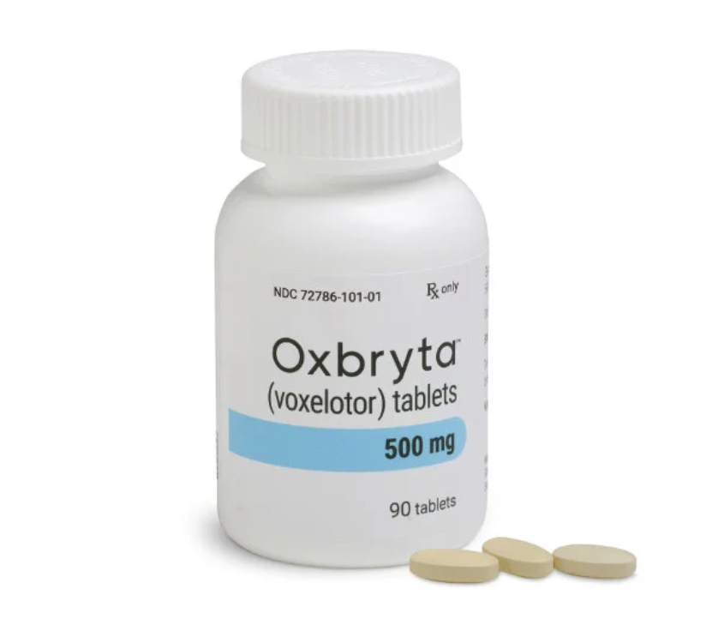
Products/Relevant Technologies
Product/Technology I
Enter_Information
Bullet_Point
Enter_Information
Bullet_Point
Product/Technology II
Enter_Information
Bullet_Point
Enter_Information
Bullet_Point
Product/Technology III
Enter_Information
Bullet_Point
Enter_Information
Bullet_Point

Slide 13
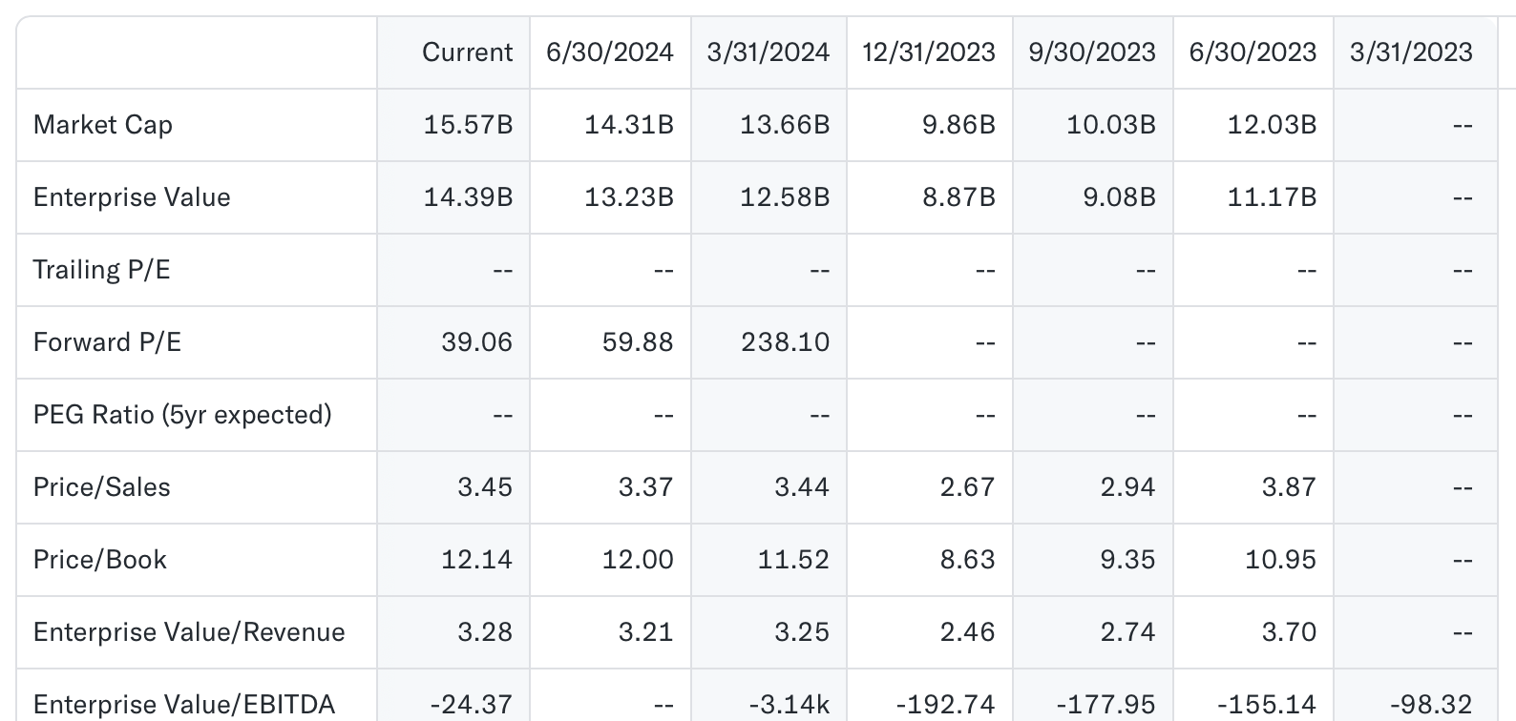
Financials, Valuation, and Outlook
Current Financials
Enter_Information
Bullet_Point
Enter_Information
Bullet_Point
Enter_Information
Bullet_Point
Enter_Information
Bullet_Point
Future Expectations
Enter_Information
Bullet_Point
Enter_Information
Bullet_Point

Slide 14
Peer Comparison
Peer I
Enter_Information
Bullet_Point
Enter_Information
Bullet_Point
Peer II
Enter_Information
Bullet_Point
Enter_Information
Bullet_Point
Peer III
Enter_Information
Bullet_Point
Enter_Information
Bullet_Point
Company | Debt/Assets | Debt/Equity | Debt/EBITDA | Current Ratio
Pfizer Inc. (NYSE: PFE) | 0.312 | 0.68 | 5.1614 | 1.651
Merck & Company Inc. (NYSE: MRK) | 0.219 | 0.34 | 1.752 | 2.309
AstraZeneca PLC (NASDAQ: AZN) | 0.283 | 0.59 | 1.468 | 1.632
Source: ATTOM Data Solutions, The White House
Notes:
Investment Thesis: Leveraging Pfizer's Strategic Acquisitions and Oncology Focus for Long-Term Growth
Introduction:
Pfizer, a pharmaceutical giant, has strategically positioned itself to navigate the challenges posed by patent expirations of its blockbuster drugs by engaging in strategic acquisitions and focusing on oncology treatments. This investment thesis proposes a BUY recommendation for Pfizer stock, capitalizing on the company's commitment to leveraging mergers and acquisitions (M&A) to mitigate revenue loss and its focus on the oncology market.
1. Strategic Acquisitions and Oncology Focus:
Pfizer has a history of strategic acquisitions aimed at bolstering its oncology portfolio, exemplified by the recent acquisition of Seagen in December 2023. With several patents for oncology drugs set to expire by the end of the decade, representing 40% of the company's 2021 revenue, Pfizer's focus on expanding its oncology pipeline through M&A activity is expected to continue. Moreover, the announcement last Thursday of their establishment of a dedicated cancer research business unit underscores Pfizer's long-term commitment to the oncology market.
2. Revenue Diversification and Growth Prospects:
Despite recent declines in revenue attributed to factors such as the expiration of patents and fluctuations in demand for COVID-19 treatments, Pfizer's strategic investments in oncology are poised to drive revenue diversification and long-term growth. The company's focus on developing eight blockbuster cancer drugs by 2030 signals its intent to capitalize on emerging opportunities in the oncology space.
3. Timing Opportunity:
Pfizer's stock currently sits at a low valuation, presenting an opportune moment for investors to capitalize on the company's growth potential. With Pfizer transitioning from an investment phase to an execution phase in 2024, investors can anticipate the realization of growth initiatives, particularly in the oncology segment.
4. Risk Considerations:
While Pfizer faces challenges such as declining demand for certain products and ongoing integration following acquisitions, these factors are mitigated by the company's robust balance sheet, strategic focus, and long-term growth prospects in oncology.
Conclusion:
In light of Pfizer's strategic acquisitions, focus on oncology, and favorable valuation, this investment thesis recommends a BUY position on Pfizer stock. Despite short-term challenges, Pfizer's long-term growth trajectory, driven by its commitment to oncology and M&A activity, positions it as a compelling investment opportunity for investors seeking sustainable growth prospects in the pharmaceutical sector.
Disclaimer:
Investors should conduct their own due diligence and consider their risk tolerance before making any investment decisions. The analysis provided here is for informational purposes only and does not constitute financial advice.

Slide 15
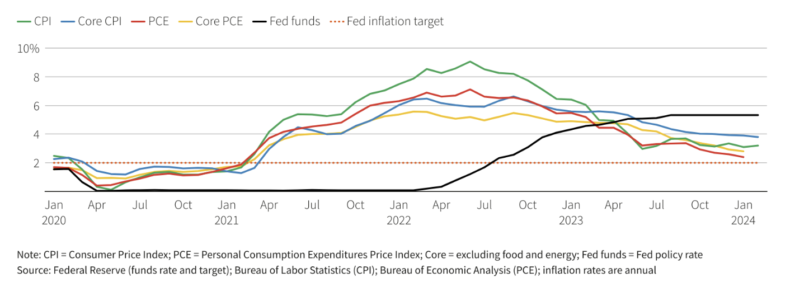
Macro/Policy/Market Outlook
Enter_Information
Bullet_Point
Enter_Information
Bullet_Point
Enter_Information
Bullet_Point

Slide 16
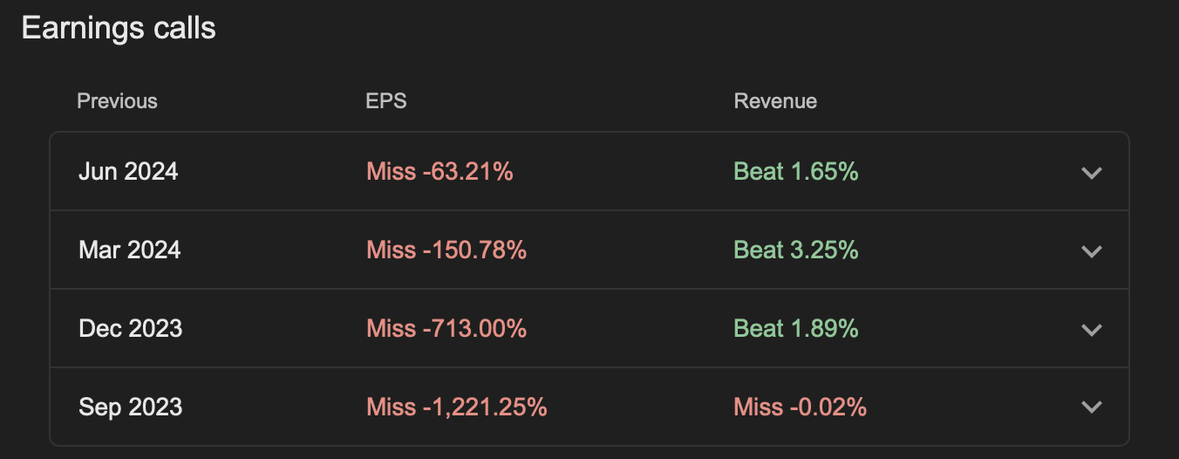
Bull/Bear Scenario
Bull
Enter_Information
Bullet_Point
Enter_Information
Bullet_Point
Enter_Information
Bullet_Point
Bear
Enter_Information
Bullet_Point
Enter_Information
Bullet_Point
Enter_Information
Bullet_Point
Notes:
but we need to consider other external factors to the company’s performance like the fall of covid

Slide 17
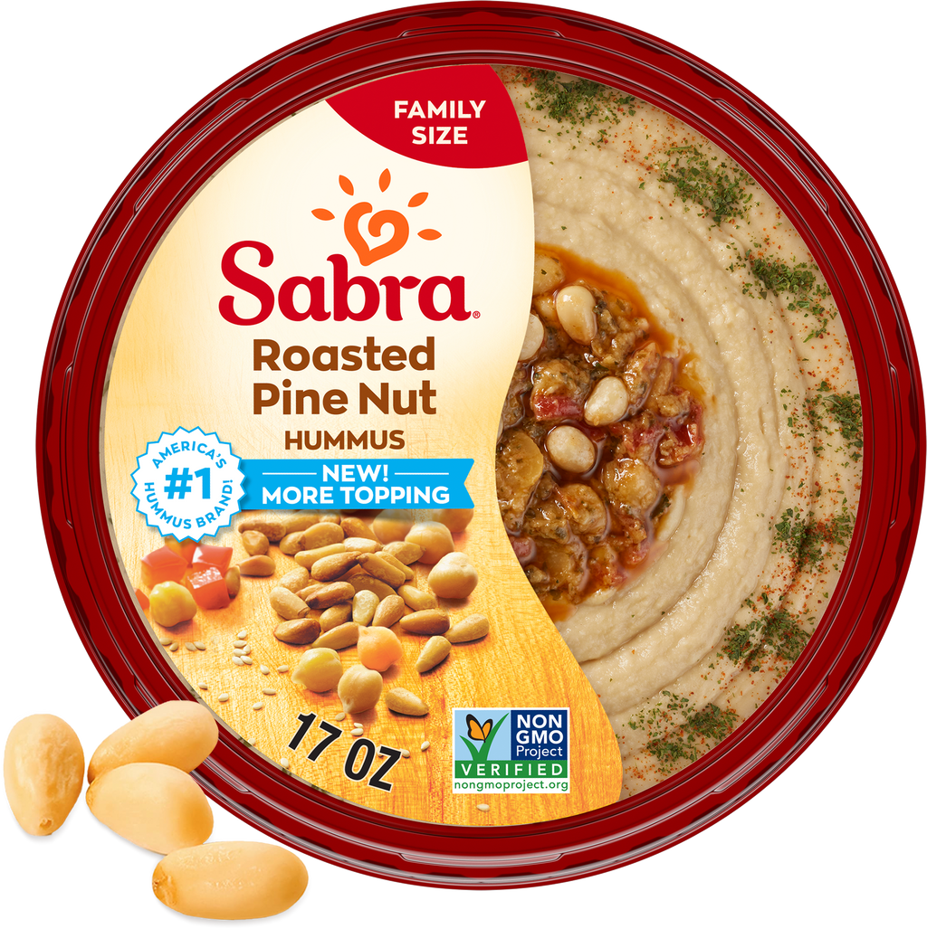
Conclusion
Investment
Enter_Information
Bullet_Point
Enter_Information
Bullet_Point
Enter_Information
Bullet_Point
Timeline
Enter_Information
Bullet_Point
Enter_Information
Bullet_Point
Enter_Information
Bullet_Point
Notes:
Pfizer 2022 ESG Report: https://www.pfizer.com/sites/default/files/investors/financial_reports/annual_reports/2022/files/Pfizer_ESG_Report.pdf
HHS climate pledge: hospitals, health systems, payers, suppliers, and pharmaceutical companies to reduce GHG emissions
EPA Clean Air Violations: https://www.epa.gov/archive/epapages/newsroom_archive/newsreleases/462ce62646fddc77852574710067a592.html
Violation Tracker: https://violationtracker.goodjobsfirst.org/violation-tracker/pr-pfizer-pharmaceuticals-llc
Puerto Rico Pharma Waste: https://www.motherjones.com/environment/2022/10/big-pharma-is-flooding-puerto-rico-with-toxic-waste/

Slide 18
4.
Industry Updates

Slide 19
24-25 Fintech Trends & Upcoming IPOs
Growing Interest in Embedded Finance
Integration of financial services into non-financial websites and apps.
EX) BNPL (Buy Now Pay Later), Embedded Payments (Digital Wallet)
80% of Gen Z use Digital Wallets and they spend 31% more than non-Wallet
Market currently sits at $63.2B → Projected to reach $248B by 2032
Regtech Solutions Provide Accuracy and Efficiency
+ 30% of financial institutions spend more than 5% of their revenue on compliance.
Upcoming IPOs: Klarna, Plaid
Notes:
EF - in the high level, for greater convenience
BNPL = Instead of needing to visit a bank to get a loan and spend hours on paperwork, consumers can access credit without leaving the platform they’re on.
JP Morgan was forced to pay $125 million for failing to follow correct compliance controls.
Usually third party specialist resources or additional senior staff to handle regulatory reqs.
Visa Pioneers New Payment Method

Slide 20
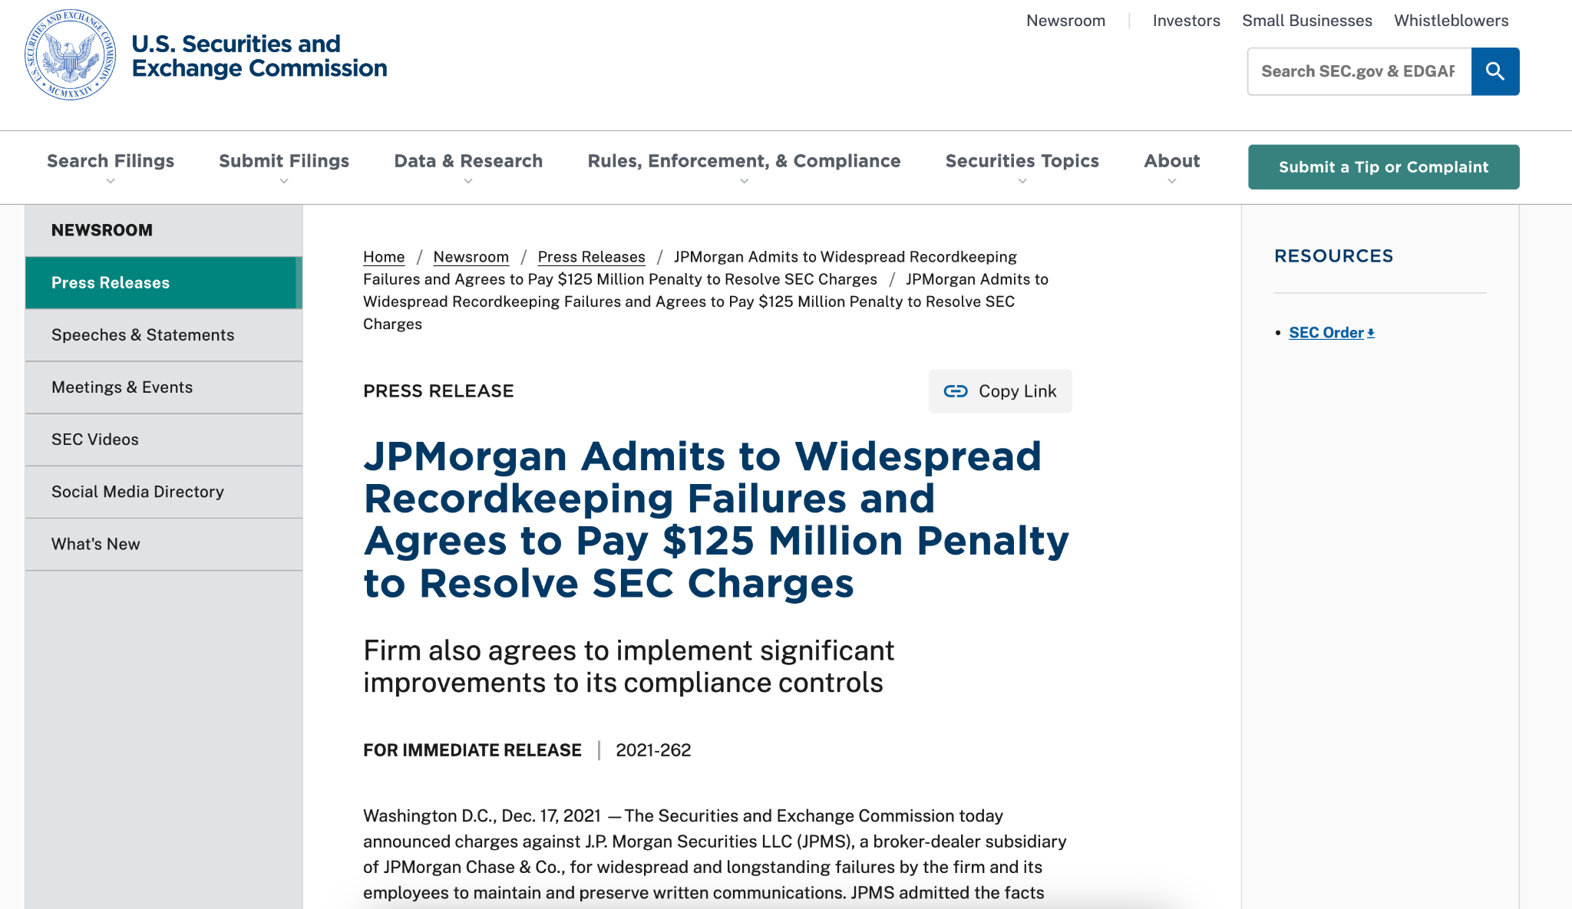
Notes:
Klarna – Swedish fintech and e-commerce company. The company provides consumers with a comparison shopping platform and flexible payment options commonly called a buy-now-pay-later (BNPL) service.
$6.7 billion Q1 2025 IPO
users have multiple no-fee flexible short-term payment options and longer-term options with financing rates ranging from 0%-29.99%
PLAID - builds application programming interfaces (APIs) for the financial industry, including banking, lending, and investing services.
analytics company, providing its customers with user insights and data.
$5 billion.potential IPO to 2025

Slide 21
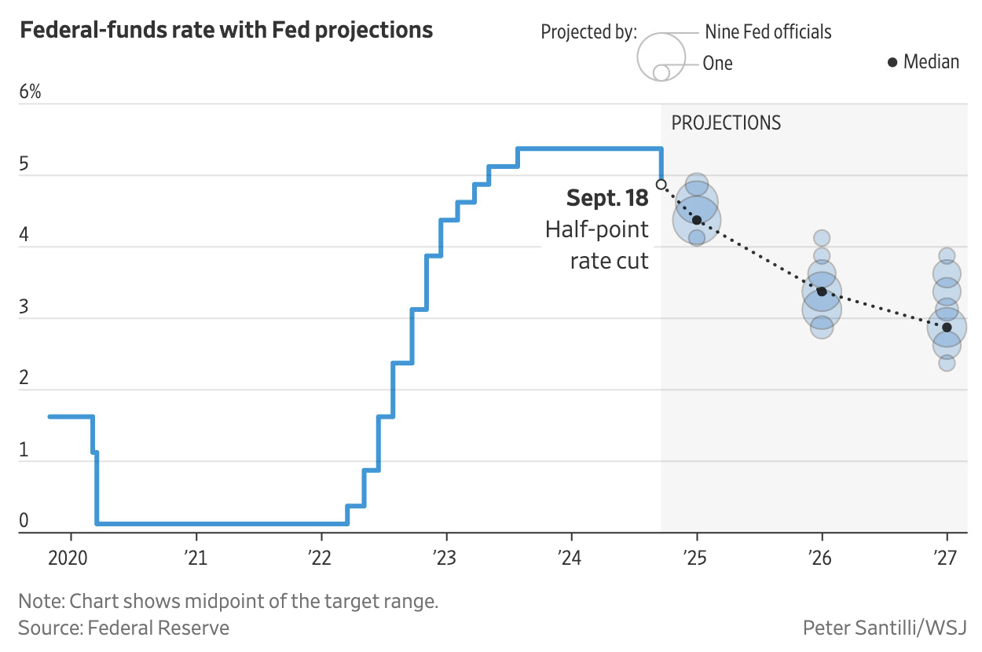
Interest Rate Cut—How will Crypto React?
Rate cut by 0.5% on 9/18
S&P500 +1.9%
NASDAQ-100 +2.1%
BTC +3.3%
ETH +8.2%
Lower interest rate → more money in circulation → more risky investments

Slide 22
M2P Fintech’s $102M Series D Round
India-based startup offering API solutions for management of banking, lending, and payment services
Round led by Helios Investment Partners, an Africa-based VC firm
Strategic play to expand its international presence
Currently 60% of revenue from India (40% international)
Projected $800M post-money valuation
CEO eyeing IPO in next 2-3 years
Takeaway: continued trend of India VC boom

Slide 23
Next Week:
Pitch by Payments Vertical
Grace - Oversight
Kiernan
Miles
Will
Akarsh
Korgan
Introduce yourself to Grace now to exchange info!

